Slide 1
Path planning and Adaptive MPC for differential drive
MSc 1, Timur Bayburin,
MSc 1, Denis Davletshin

Slide 2
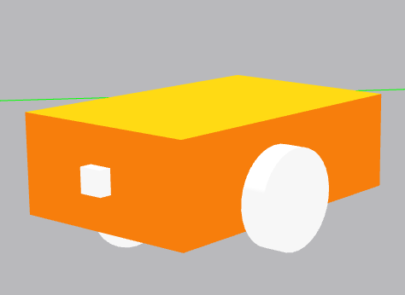
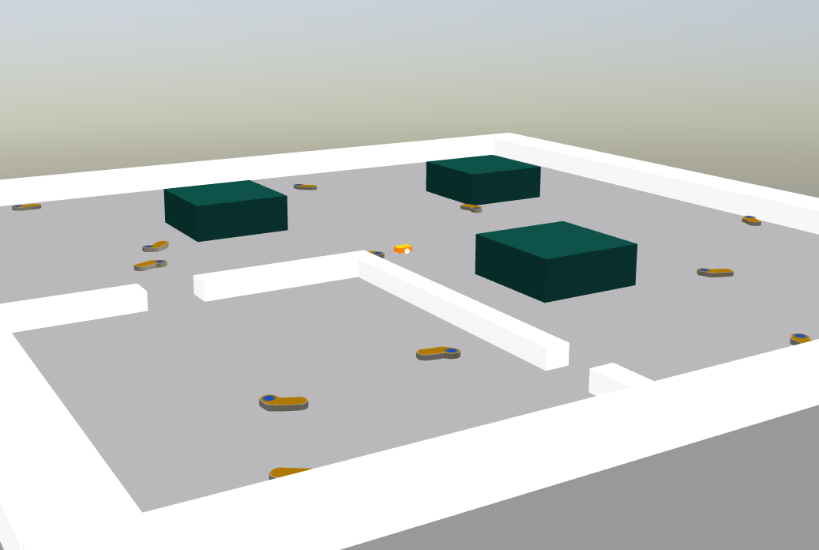
Objectives
Task
We need to collect all socks in the map
Constraints
Simulation
3 wheeled differential robot
Socks as targets
Walls as obstacles

Slide 3
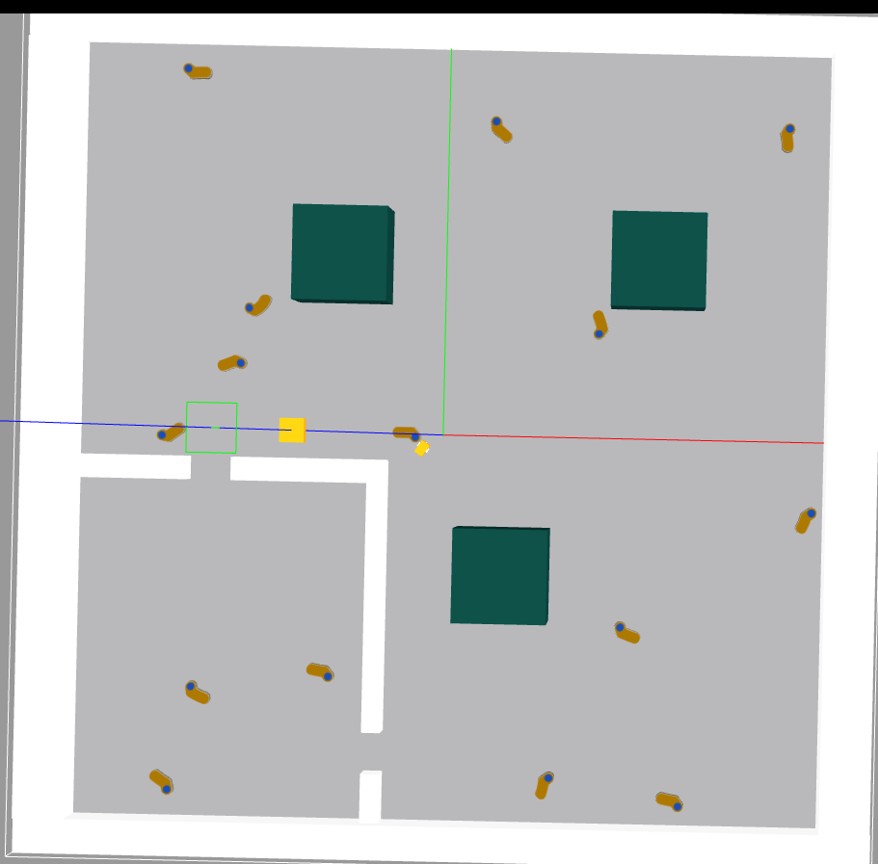
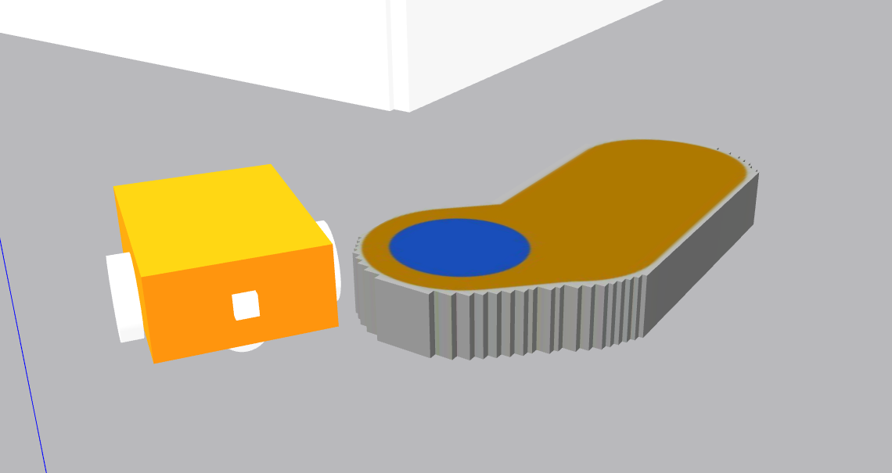
What can we use?
This cute one and its odometry
top camera view
+
Possibility to controll velocity

Slide 4

Proposed solution
CV mapping of surroundings
+
+
MPC with adaptive motion model
(on Pytorch)
Global planner (optimal path on graph).
odometry localisation

Slide 5
Computer vision mapping
Classical approaches
Distinguishable colors
Constant conditions
Constant filters
Search contours
Ready map for path planner

Slide 6
Global path planner
get next target
Build local path
reach goal
Nearest object by L2 metric
A* algorithm
MPC

Slide 7


Motion models for MPC
State
Control

Slide 8
MPC implementation
next target
refference path
find optimal M step controls with NN
1 propogation step
Local planner
model correction
position measurement

Slide 9
Loss function
Refference trajectory that avoids obstacles
Σ of deviations
Obstacle

Slide 10
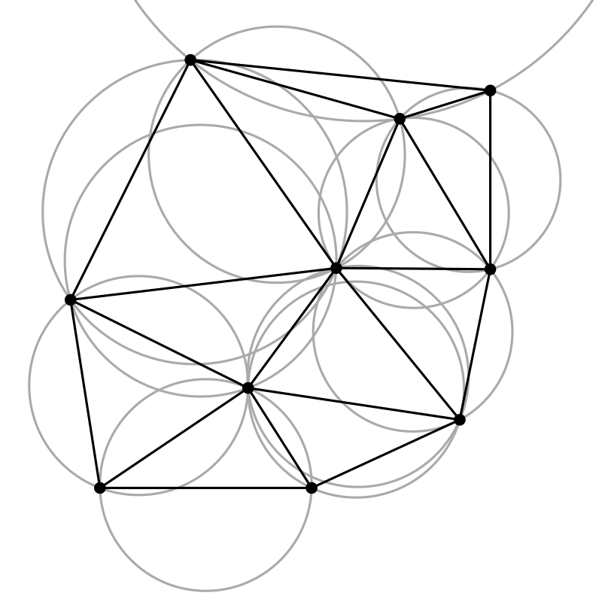
What we have now and future plans
Computer vision mapping
MPC partial implementation
A* planner
Odometry & CV fusion
AMPC implentation
Delanoy triangulation

Slide 11
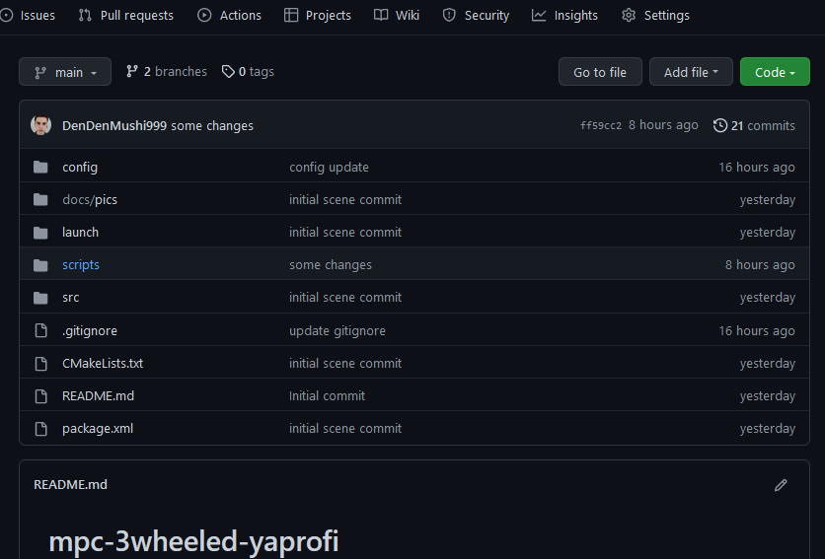
Repository

Slide 12
Ready for your questions

